Slide 1

But I have
SCORM!

Slide 2


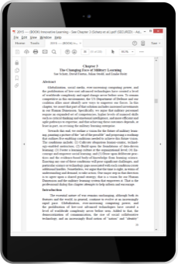

SCORM
xAPI
CONTENT
DATA
e-Learning
with a Learning Management System
Any Technology
that can use the internet

Slide 3

SCORM
xAPI
DATA
CONTENT
e-Learning
with a Learning Management System
Any Technology
that can use the internet
Notes:
To be fair, SCORM does include some very basic outcome data reporting capabilities, which xAPI can also support. We’ll get to that in a moment.

Slide 4


Slide 5
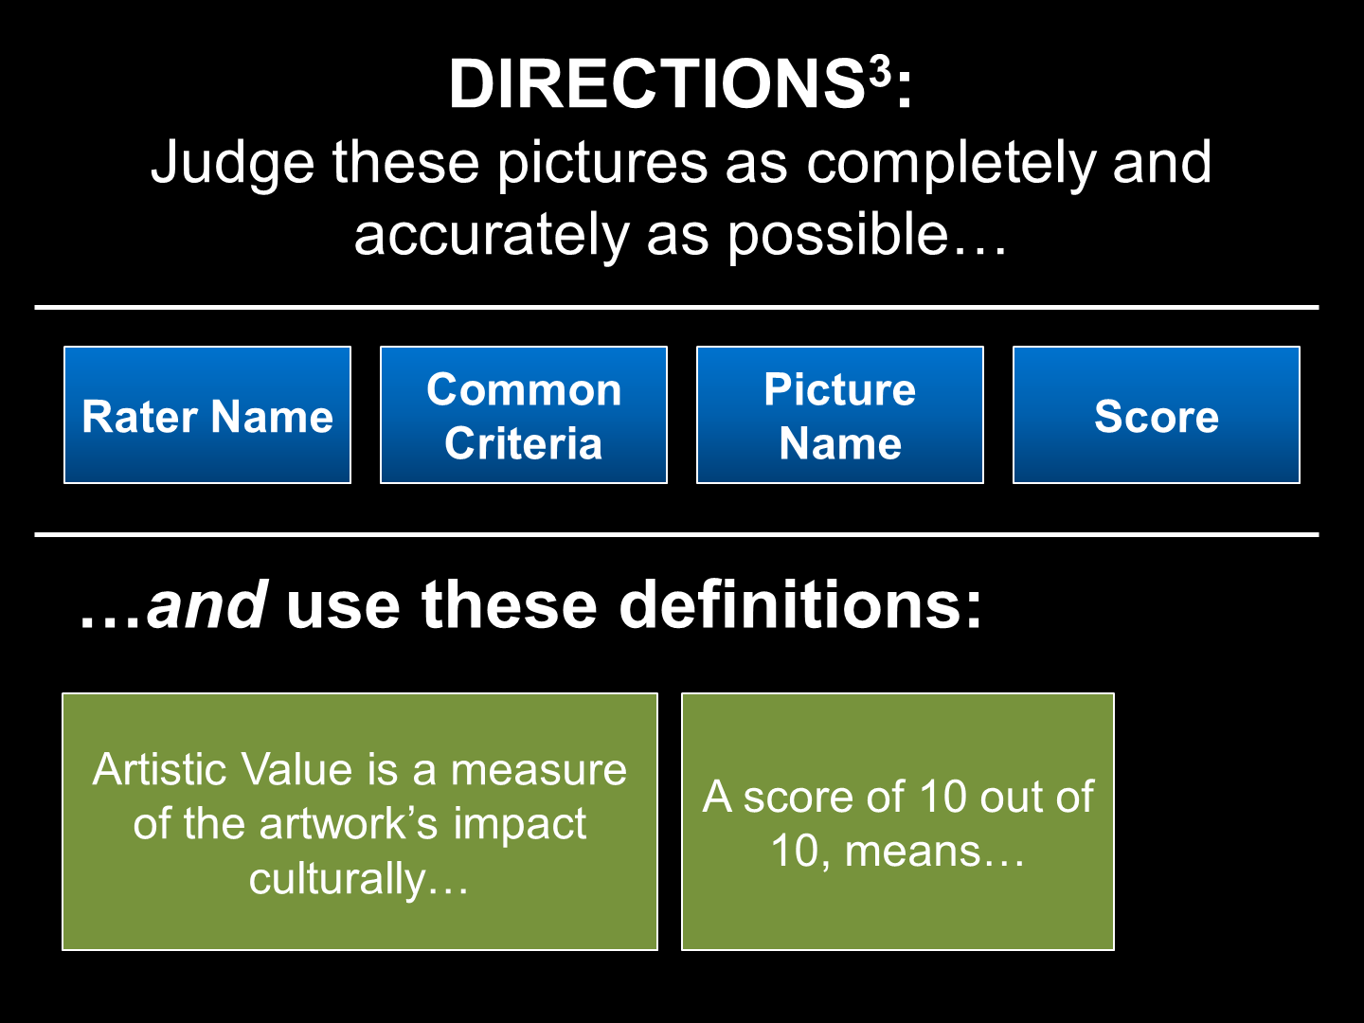

xAPI Profiles for e-Learning
Profiles are the set of vocabulary terms and usage rules for a particular domain.
Notes:
xAPI’s flexible and extensible data model makes it easy for Learning Record Providers to encode many different types of learning experiences. However, this flexibility makes it difficult for Learning Record Consumers to make sense out of that data. A common vocabulary needs to exist so that both providers and consumers can understand the data represented in an xAPI statement.
Profiles are the set of vocabulary terms and usage rules for a particular domain. Using these vocabularies and rules, developers can create interoperable statements. The xAPI SCORM Profile and cmi5 are two examples of profiles. In this regard they are similar since they both define terms and usage examples. But they are very different in the scope and purpose.
Can you use multiple profiles? Yes, e.g., implementing SCORM, video, and personalized homemade profiles

Slide 6
xAPI SCORM Profile
LRS
LMS
xAPI
DATA
SCORM CONTENT
SCORM Run-Time Data
Notes:
The purpose of the SCORM Profile is to ensure all SCORM data is represented in the same format in an xAPI LRS.
The SCORM Profile only focuses on representing SCORM Run-Time data in an xAPI LRS, which allows organizations to continue to use their existing training infrastructure.
SCORM data that was previously siloed in the LMS now is available through the standardized xAPI.
Trainers can also create non-SCORM content - apps, simulations - that utilize the SCORM Profile statement formats, allowing for SCORM and non-SCORM to be consumed and analyzed the same way.
Defines the universal way for all organizations to represent SCORM data in an xAPI LRS
Identifies a vocabulary for representing SCORM progress, status, and session data as xAPI statements
Maps the entirety of SCORM data model elements to xAPI statements and document properties
Provides guidance on xAPI topics such as launch, user management, and ID creation
Provides example statements and scenarios

Slide 7


xAPI SCORM Profile
LRS
LMS
xAPI
DATA
xAPI
DATA
xAPI
DATA
Notes:
The purpose of the SCORM Profile is to ensure all SCORM data is represented in the same format in an xAPI LRS.
The SCORM Profile only focuses on representing SCORM Run-Time data in an xAPI LRS, which allows organizations to continue to use their existing training infrastructure.
SCORM data that was previously siloed in the LMS now is available through the standardized xAPI.
Trainers can also create non-SCORM content - apps, simulations - that utilize the SCORM Profile statement formats, allowing for SCORM and non-SCORM to be consumed and analyzed the same way.
Defines the universal way for all organizations to represent SCORM data in an xAPI LRS
Identifies a vocabulary for representing SCORM progress, status, and session data as xAPI statements
Maps the entirety of SCORM data model elements to xAPI statements and document properties
Provides guidance on xAPI topics such as launch, user management, and ID creation
Provides example statements and scenarios

Slide 8
xAPI SCORM Profile
Represents SCORM data in an xAPI format
Maps the entirety of SCORM data model to xAPI
Defines a vocabulary for representing SCORM progress, status, and session data as xAPI statements
Provides guidance on xAPI topics such as launch, user management, and ID creation
Only represents SCORM Run-Time data in xAPI, so organizations can use existing training infrastructure
Notes:
The purpose of the SCORM Profile is to ensure all SCORM data is represented in the same format in an xAPI LRS.
The SCORM Profile only focuses on representing SCORM Run-Time data in an xAPI LRS, which allows organizations to continue to use their existing training infrastructure.
SCORM data that was previously siloed in the LMS now is available through the standardized xAPI.
Trainers can also create non-SCORM content - apps, simulations - that utilize the SCORM Profile statement formats, allowing for SCORM and non-SCORM to be consumed and analyzed the same way.
Defines the universal way for all organizations to represent SCORM data in an xAPI LRS
Identifies a vocabulary for representing SCORM progress, status, and session data as xAPI statements
Maps the entirety of SCORM data model elements to xAPI statements and document properties
Provides guidance on xAPI topics such as launch, user management, and ID creation
Provides example statements and scenarios

Slide 9
xAPI cmi5 Profile
Sequencing
Launching
LRS
LMS+
MORE
DATA
SCORM CONTENT
Notes:
cmi5 defines requirements for both an LMS and the content, including packaging, launch, and reporting data.
It enables organizations without a current learning infrastructure to put in place an LMS that also provides the xAPI endpoints
It uses xAPI to encode the learners’ progress and transmit the data back to the LMS.
It defines a vocabulary for reporting learner progress, allowing for consuming the data in a consistent way.
Defines behaviors and responsibilities of LMSs beyond tracking, such as launch and sequencing
Requires the LMS to create and maintain the course structures
Defines behaviors and responsibilities of content, such as packaging and sessions
Uses xAPI’s endpoints and statements format for its data transport and encoding
Defines a vocabulary for learner progress and status in xAPI

Slide 10
xAPI cmi5 Profile
Adds capabilities beyond the xAPI SCORM Profile
Defines behaviors and responsibilities of LMSs beyond tracking, such as launch and sequencing
Defines a vocabulary for learner progress and status
Requires LMSs to create and maintain course structures, and defines behaviors and responsibilities of content, such as packaging and sessions
Notes:
cmi5 defines requirements for both an LMS and the content, including packaging, launch, and reporting data.
It enables organizations without a current learning infrastructure to put in place an LMS that also provides the xAPI endpoints
It uses xAPI to encode the learners’ progress and transmit the data back to the LMS.
It defines a vocabulary for reporting learner progress, allowing for consuming the data in a consistent way.
Defines behaviors and responsibilities of LMSs beyond tracking, such as launch and sequencing
Requires the LMS to create and maintain the course structures
Defines behaviors and responsibilities of content, such as packaging and sessions
Uses xAPI’s endpoints and statements format for its data transport and encoding
Defines a vocabulary for learner progress and status in xAPI

Slide 11
Way Ahead
(Roadmap)

Slide 12
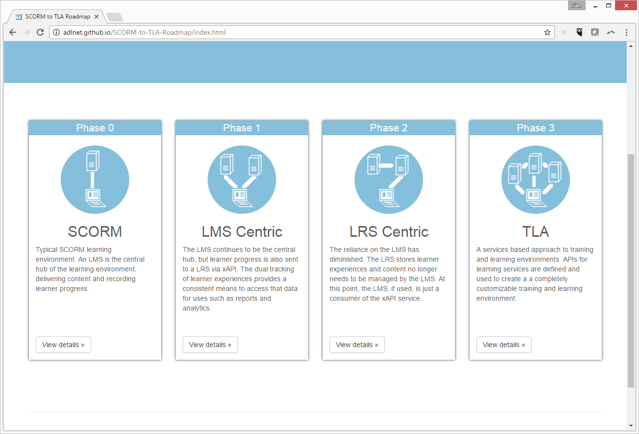
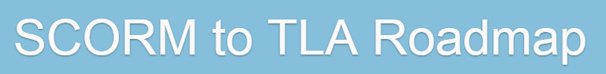

http://adlnet.github.io/SCORM-to-TLA-Roadmap
Notes:
The SCORM to TLA Roadmap is a collection of phases, or strategies, organizations can adopt to blend new technologies of the TLA with their current SCORM infrastructure. Each phase contains a description, including criteria to help decide if this phase is for an organization, a list of benefits, and helpful transition information and links.
Although the phases are ordered to offer a progressive shift away from an organization’s reliance on their SCORM infrastructure, it is not necessary to implement the phases in order. Organizations may skip phases as their needs dictate.
The SCORM and TLA phases are the starting and end states. In addition to those two states, there are two strategies organizations can use to leverage xAPI within their training infrastructure. It is expected that more phases will be included as integration details are identified.

Slide 13
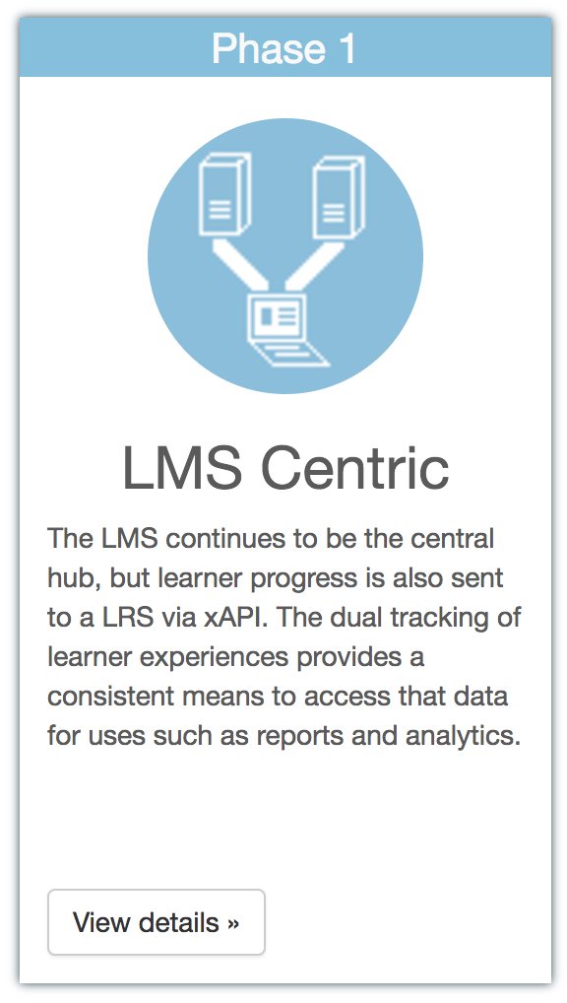
Phase 1
SCORM LMS remains the center for the system
Existing infrastructure remains the same; no changes to your LMS!
Data are sent to the LRS
Notes:
The SCORM LMS remains at the center of the learning infrastructure, delivering courses, managing learners and their progress.
In addition, the content, or a component of the LMS, is modified to send learners’ progress to an xAPI LRS, using the SCORM Profile data format rules.
The communication between the content and LMS is left intact ensuring that learner progress and content sequencing continues to work as it did before.
But by sending the data to an xAPI LRS, the learner’s progress data is available through a standard API and in a specified data format that allows consistent reporting and analytics without needing proprietary access to the LMS data.
SCORM content still reports progress and status directly to the LMS
SCORM content also sends the progress and status data to an LRS using the xAPI SCORM Profile data format rules
Since the data is being stored in an LRS using the SCORM profile format, it is easy for reporting and analytics tools to retrieve and interpret the data
The courses can also be updated to report additional information not tracked by SCORM to the LRS
And, additional tools like job aids and supporting material can report usage data to the LRS, allowing this to be collected with data from the course

Slide 14
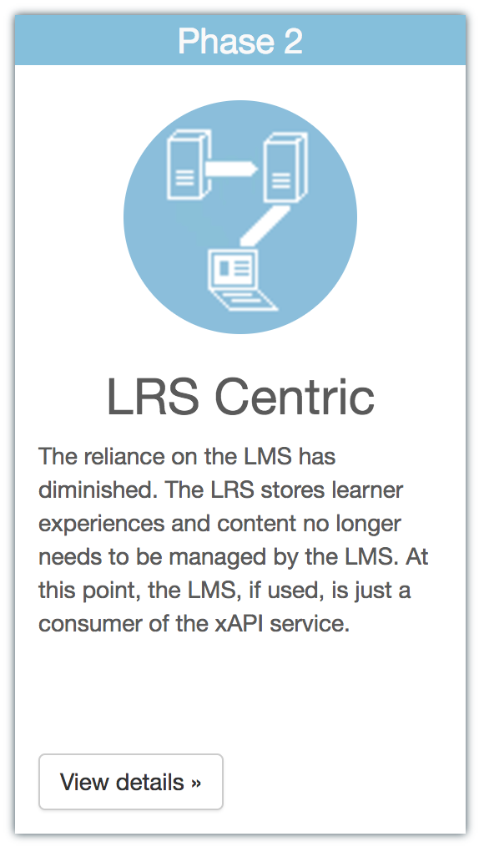
Phase 2
xAPI LRS is the center of the system
The LRS and LMS “talk” to each other
The LMS uses the LRS data to update its internal states
Other applications (e.g., mobile apps) use the same LRS, so SCORM and non-SCORM content are “equal”
Notes:
The xAPI LRS, or LRSs, is the central location for all learning experience data.
Learner progress and SCORM data are sent to the LRS using the formats defined in the xAPI SCORM Profile.
The SCORM LMS acts as a learning record consumer, querying the LRS for learning experiences and using that data to update its internal learner status.
Using the SCORM profile data formats and the LRS as the central store of learning progress, LMSs can collect learner progress for both SCORM content and content generally not supported by SCORM
All learning experience data goes to the LRS first
LMSs query the LRS just like other client applications, and uses the xAPI statements to update its internal learner status
LMSs can still deliver content and manage users, but the definitive data is stored in the LRS, not the LMS.
This allows all content to be treated the same, whether it was launched by the LMS or some other method - meaning equal support for SCORM content and non-SCORM content like mobile and simulations

Slide 15
Phase 3
New learning environment of specs and standards
Various learning technology applications, e.g., mobile, blended learning, performance support
Maximum flexibility
Notes:
This phase is currently a catch-all for any future compontents of the Training and Learning Architecture. As the learning environment becomes more services focused, other aspects traditionally provided by an LMS will be defined as stand-alone components with standard interfaces. This approach will allow organizations to choose which components are right for them without the concerns of compatibility with existing services.
For you if..
Your organization does not have an existing LMS.
Your organization has a high tolerance for risk and change, and wants to be frontrunners of new learning environment specifications and standards.
Your existing or potential learning experience designs include various learning technology applications: mobile, blended learning, performance support, coaching, etc.
You want maximum flexibility in collecting learner experience data, and want to use that data to influence learning experience design and implementation.

Slide 16
http://adlnet.github.io/SCORM-to-TLA-Roadmap

